Slide 1
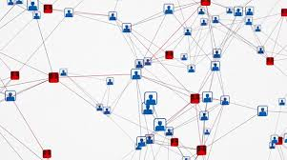


Fake Social Media Profile Detection
Our Team: Supervisors:
Umita Joshi Dr. Gaurav Singal
Tushar Pahuja Smita Naval
Vanshika
Ajay Pratap Singh

Slide 2
Introduction
Increase in popularity of social network
Major concern – Creation of fake accounts
Importance of detection of fake accounts
Creating fake accounts causes more damage than any other cybercrime

Slide 3
Dataset Used
The dataset focus on find fake account that are human-like
The dataset has been taken from http://mib.projects.iit.cnr.it/dataset
3,351 fake profiles and 3,474 legitimate profiles
Classification based on the visible characteristics
The following traits are picked :

Slide 4
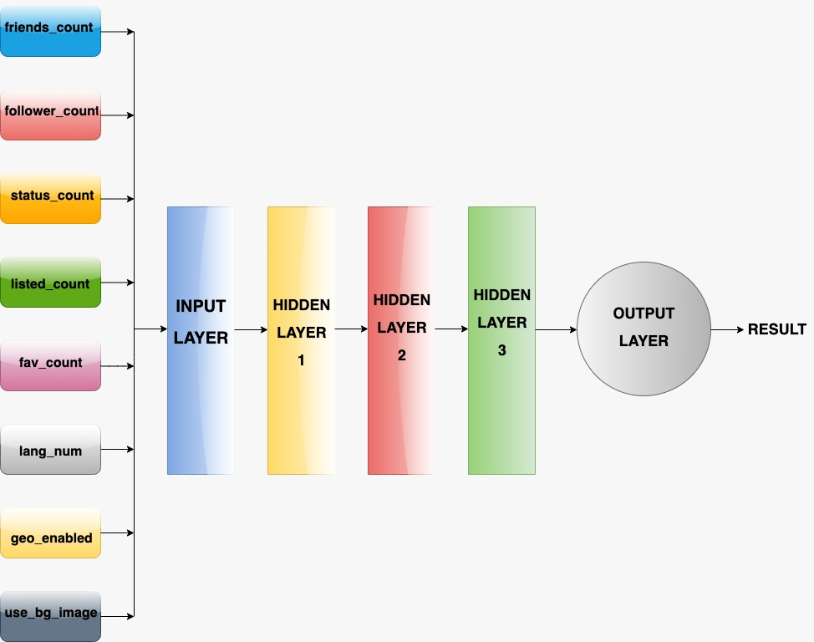
Methodology / Model Used
The Models used are:
Extreme Gradient Boosting(XGBoost)
Adaptive Boosting(AdaBoost)
Random Forest Classifier
Decision Tree Classifier
Support Vector Machine(SVM)
Artificial Neural Network
LSTM Network
Neural Network Architecture

Slide 5
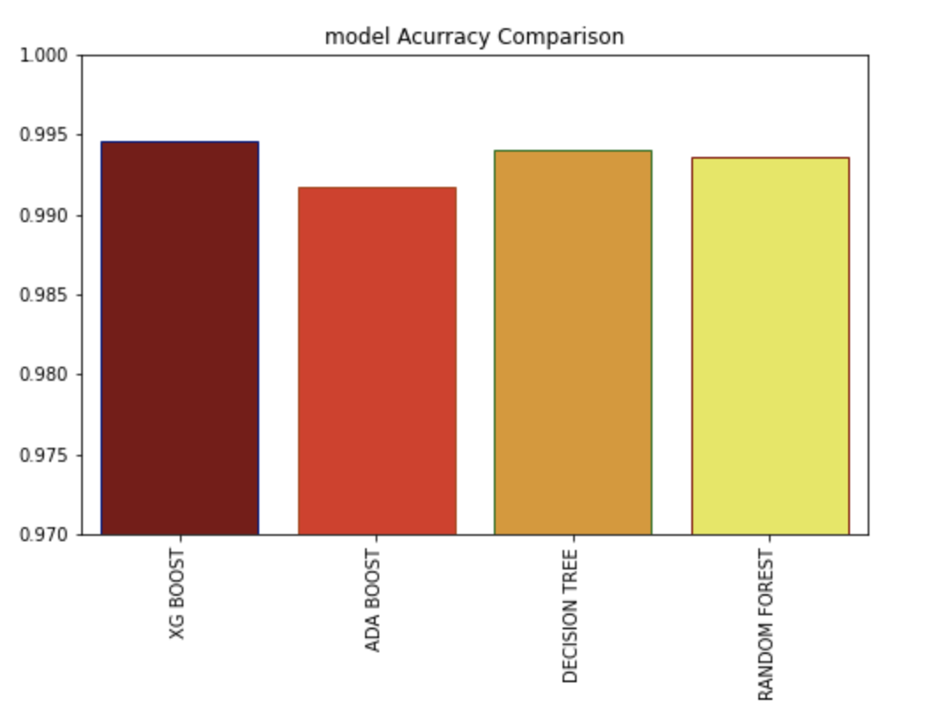
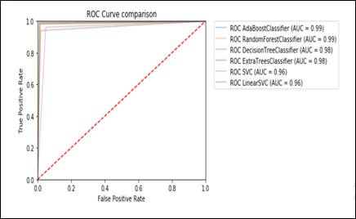
Results Achieved
Algorithm Comparison
ROC Curve Comparison

Slide 6
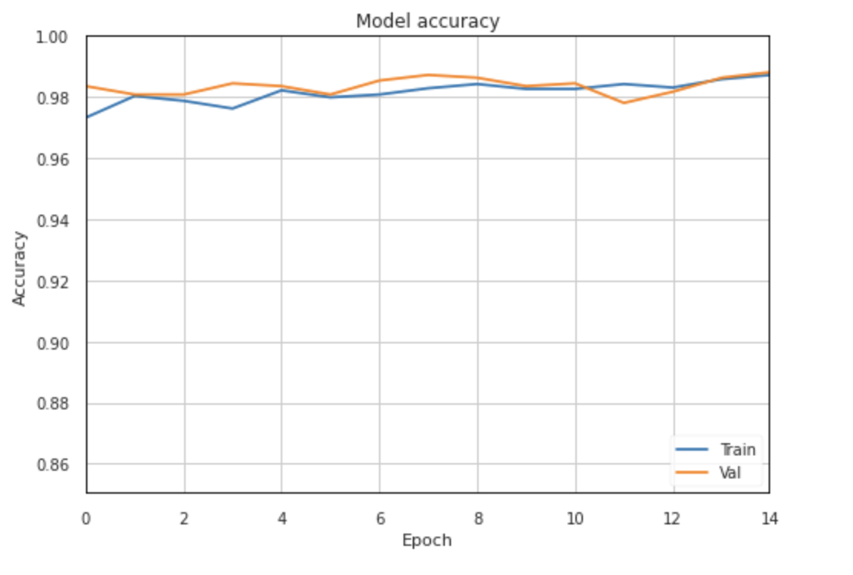
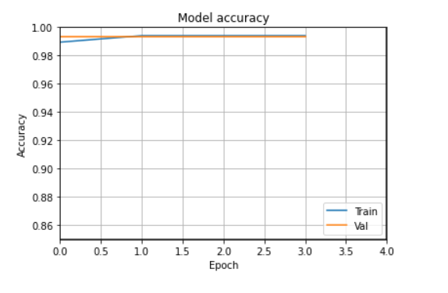
Results Achieved
ANN
LSTM

Slide 7
Conclusion
Implemented various Supervised Learning Algorithms and Neural Network
Highest Accuracy was given by XGBoost Algorithm
Limitations :
Works only on visible data
No real time application
Future work can be assembling a real-time model by including other parameters

Slide 8
References
SocialNetworksFakeProfilesDetectionUsingMachineLearningAlgorithms https://www.researchgate.net/publication/339012245/
Aleksei Romanov, Alexander Semenov, Oleksiy Mazhelis and Jari Veijalainen: Detection of Fake Profiles in Social Media
Sneha Kudugunta,Emilio Ferrara:Deep Neural Networks for Bot Detection
Analysis and detection of fake profile over social network – Vijay Tiwari
https://www.irjet.net/archives/V6/i12/IRJET-V6I12189.pdf

Slide 9
Thank You

